Slide 1
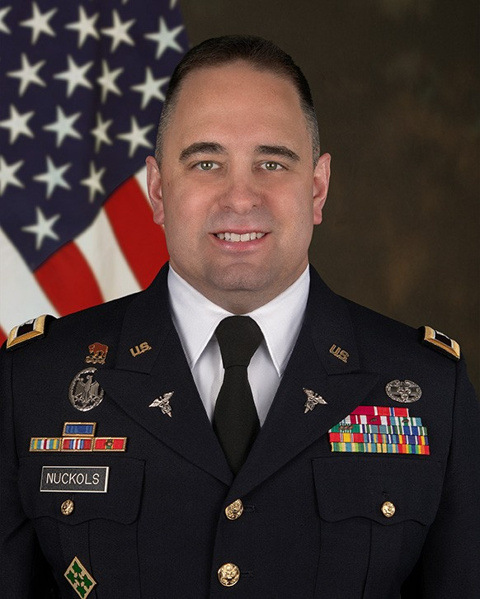
COL JOHN NUCKOLS
Joint Project Manager CBRN Medical
Colonel John T. Nuckols, Ph.D is the Joint Project Manager (JPM) for Chemical, Biological, Radiological and Nuclear (CBRN) Medical. He is responsible for leading the medical portfolio for the Joint Program Executive Office for Chemical, Biological, Radiological and Nuclear Defense (JPEO-CBRND).
COL Nuckols previously served as the Acting Principal Assistant for Acquisition to the Commanding General of the U.S. Army Medical Research and Development Command (USAMRDC).
COL Nuckols military service began in the 4th Infantry Division at Fort Hood, Texas, where his assignments included Ambulance Platoon Leader, Echo Company, 704th Division Support Battalion, and Medical Platoon Leader, Headquarters and Headquarters Troop, 1st Squadron, 10th Cavalry Regiment where he deployed to Iraq in 2003 for Operation Iraqi Freedom. Upon his return, COL Nuckols completed the U.S. Army Medical Department (AMEDD) Clinical Laboratory Officer Course at the Walter Reed Army Medical Center, earning his Medical Laboratory Scientist certification. He then served as the Clinical Lab Manager and Medical Company Commander at Baine-Jones Army Community Hospital, Fort Polk, Louisiana. COL Nuckols, selected for the AMEDD Long Term Health Education and Training program, attended The University of Texas Medical Branch in Galveston, Texas, earning a Doctor of Philosophy in Experimental Pathology. He was subsequently assigned to the Joint Vaccine Acquisition Program within the Medical Countermeasure Systems Joint Project Management Office as the Military Deputy and Recombinant Botulinum Vaccine Program Manager. He next served as the Associate Lab Director for the HIV Diagnostics and Reference Laboratory at the Walter Reed Army Institute of Research, overseeing HIV screening for Department of Defense (DOD) Military Entrance Processing Station applicants and clinical/therapeutic monitoring of HIV-infected personnel across the Joint Services. COL Nuckols was then assigned to the Walter Reed National Military Medical Center as the Director of Laboratory Operations, where he ensured the delivery of laboratory and pathology services to military beneficiaries across the National Capital Region. He then served as a Joint Product Manager for the biodefense vaccine portfolio within the JPEO-CBRND. While in this role, COL Nuckols was detailed to the DOD COVID-19 Task Force as the Joint Rapid Acquisition Cell Product Lead for Screening and Diagnostics. He supported the national pandemic response through the management of Health and Human Service investment in the construction and expansion of U.S.-based diagnostic manufacturing capabilities and the shipment of diagnostic test materials around the globe.
Address
1564 Freedman Drive
Fort Detrick, MD 21702
Phone
(301) 619-7400
Email
usarmy.apg.dod-jpeo-cbrnd.mbx.
public-affairs@army.mil
Facebook www.facebook.com/JPEOCBRND
X (formerly Twitter)
twitter.com/JPEOCBRND
LinkedIn
www.linkedin.com/company/jpeocbrnd
YouTube
www.youtube.com/c/jpeocbrnd

Slide 2
COL JOHN NUCKOLS
Joint Project Manager CBRN Medical
COL Nuckols is a Distinguished Military Graduate of the Texas A&M University-Corpus Christi ROTC program, where he earned both a Bachelor of Science and a Master of Science in Biology. COL Nuckols graduated from the US Army War College, where he earned a Master of Strategic Studies.
COL Nuckols’ awards and decorations include the Legion of Merit (one bronze oak leaf cluster (OLC)), Bronze Star Medal, Defense Meritorious Service Medal (OLC), Meritorious Service Medal (OLC), Joint Service Commendation Medal (OLC), Army Commendation Medal (three bronze OLCs), Joint Service Achievement Medal, Army Achievement Medal, Global War on Terrorism Expeditionary Medal, and the Global War on Terrorism Expeditionary Medal, and the Global War on Terrorism Service Medal. He has earned the Expert Field Medical Badge, Combat Medical Badge, and German Armed Forces Proficiency Badge. COL Nuckols proudly wears the Presidential Unit Citation and Valorous Unit Award presented to 1st Squadron, 10th Cavalry Regiment, 4th Infantry Division, for actions conducted during Operation Iraqi Freedom. COL Nuckols also wears the Joint Meritorious Unit Award and Army Superior Unit Award for exemplary performance by units that he was assigned to and contributed to the unit’s exceptional achievement.
Address
1564 Freedman Drive
Fort Detrick, MD 21702
Phone
(301) 619-7400
Email
usarmy.apg.dod-jpeo-cbrnd.mbx.
public-affairs@army.mil
Facebook www.facebook.com/JPEOCBRND
X (formerly Twitter)
twitter.com/JPEOCBRND
LinkedIn
www.linkedin.com/company/jpeocbrnd
YouTube
www.youtube.com/c/jpeocbrnd

