Slide 1
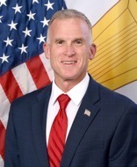
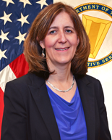
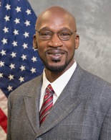
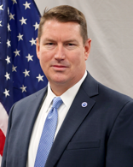
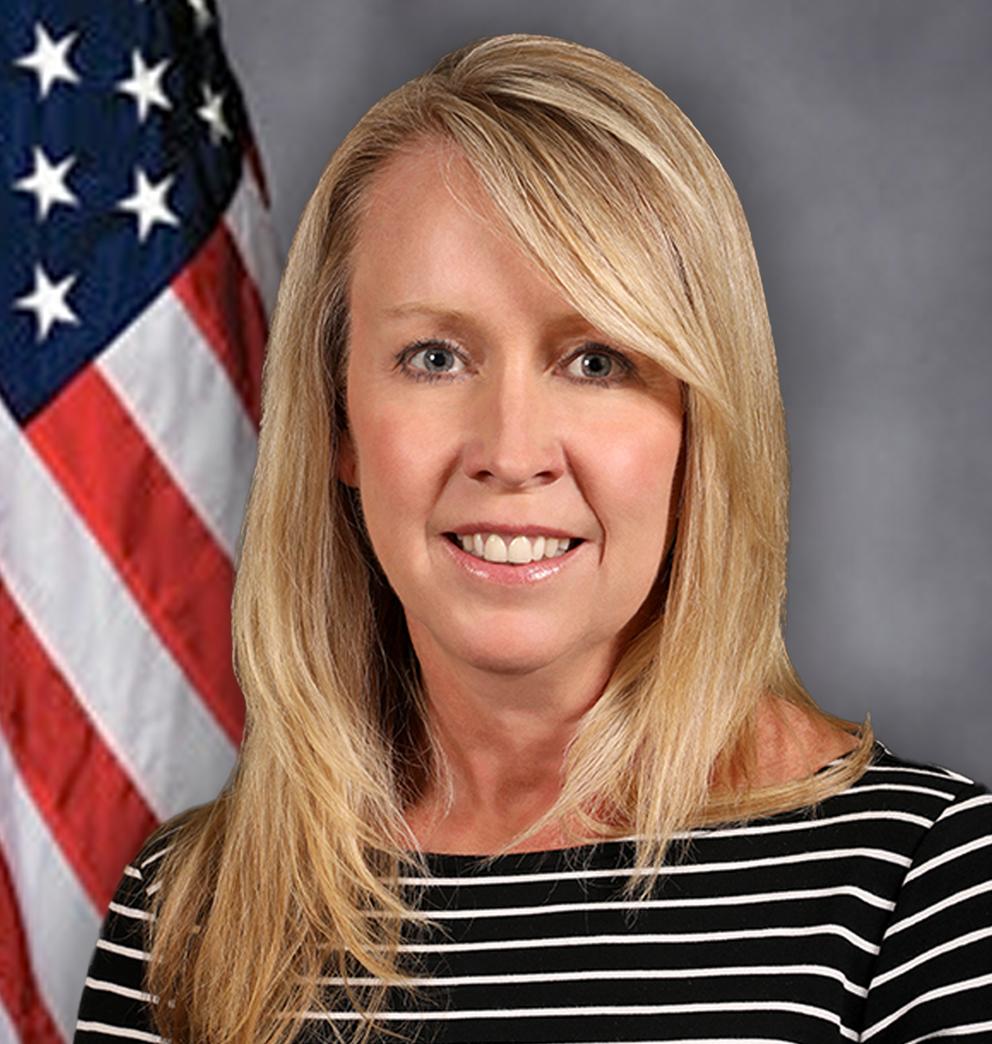
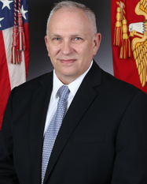
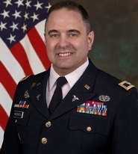
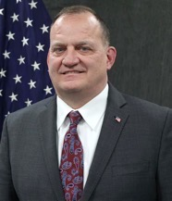
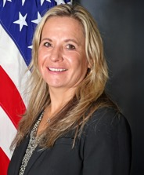
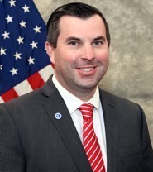
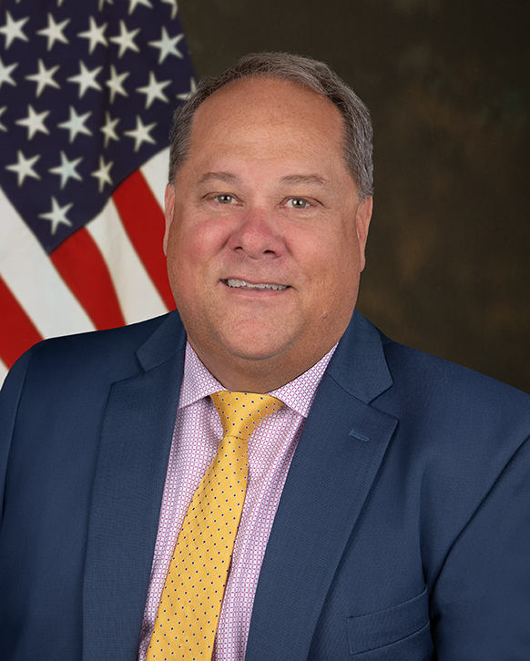
JPEO-CBRND
ORGANIZATION Leadership
UNCLASSIFIED
JPEO
Mr. Darryl Colvin
Executive Assistant
Ms. Quneitra Quintero
Deputy JPEO
Ms. Nicole Kilgore
Executive Assistant
Ms. Carol Keyes
Chief of Staff
Mr. Gordon Graham
Director for Acquisition
& Systems Management
Mr. Wyatt Ulrich
Joint Warfighter
Concept Integrator
Ms. Rachel Overman
Joint Project Managers (JPM)
Joint Project Leads (JPL)
JPM CBRN Protection
Mr. Steven Batts
JPM CBRN Medical
COL John Nuckols​
JPM CBRN Sensors
Mr. Timothy Tharp
Acting JPM CBRN Special Operations Forces
Ms. Deborah Olson
JPL CBRN Integration
Mr. Paul Gietka
JPL CBRND
Enabling Biotechnologies
Mr. Bruce Goodwin
Deputy JPM
Ms. Stacey Shepherd
***************
Executive Assistant
Ms. Brenda Lopez-Price
Deputy JPM
Mr. Jeff Zerhusen
***************
Executive Assistant
Ms. Holly Randles
Deputy JPM
Mr. L. Clay Williamson
***************
Executive Assistant
Ms. Nicole Harris
Deputy JPM
TBA
***************
Executive Assistant
Ms. Michelle Stier
Deputy JPL
LTC Denyada Barnes
***************
Executive Assistant
Ms. Jeanette Benton
Deputy JPL
Ms. Nicky Dorsey
***************
Executive Assistant
Ms. Nehemirah Maxwell
Notes:
JPEO Leadership
Now, let’s take a look at the leaders that drive the strategy and goals for the JPEO.
Mr. Darryl Colvin is our JPEO, and Ms. Nicole Kilgore is our Deputy JPEO.
We have four Joint Project Managers that develop equipment for the warfighter, each with a different focus area. They are CBRN Protection, CBRN Medical, CBRN Sensors, and CBRN Special Operations Forces.
We also have two Joint Project Leads that coordinate across the JPMs and Chem-Bio Defense Community. They are CBRN Integration and CBRND Enabling Biotechnologies.

